Slide 1
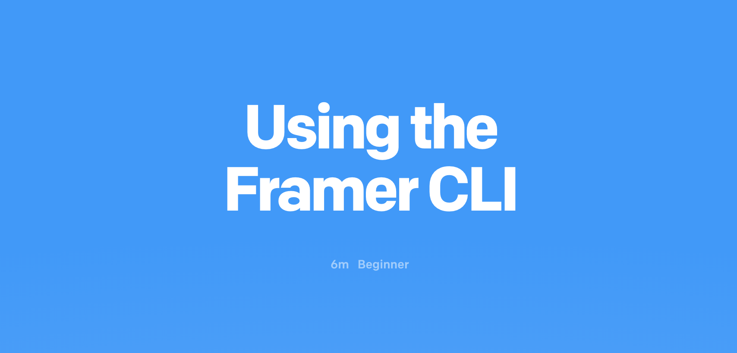

Slide 2

Framer CLI
The Framer CLI allows for the building and publishing your Framer folder projects via the command line.

Slide 3
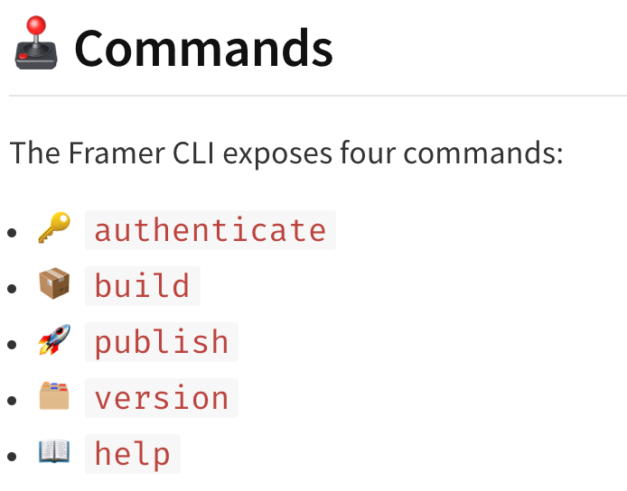

Slide 4
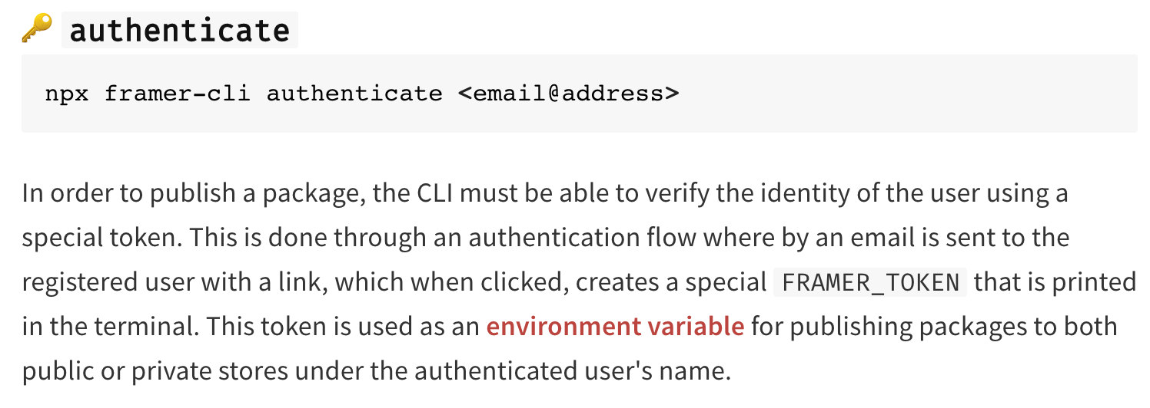

Slide 5
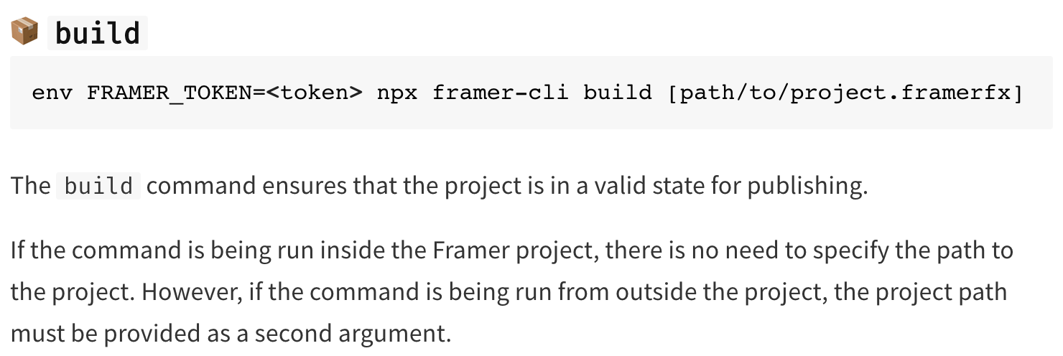

Slide 6
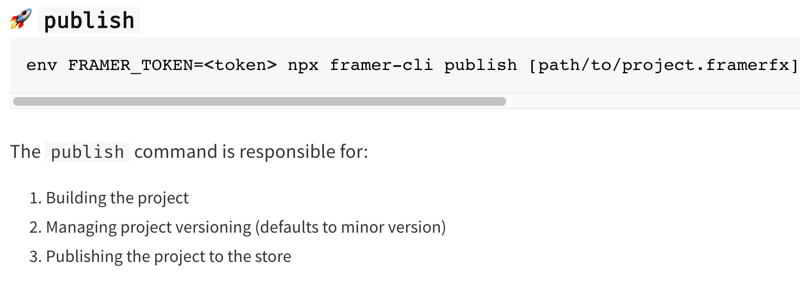

Slide 7
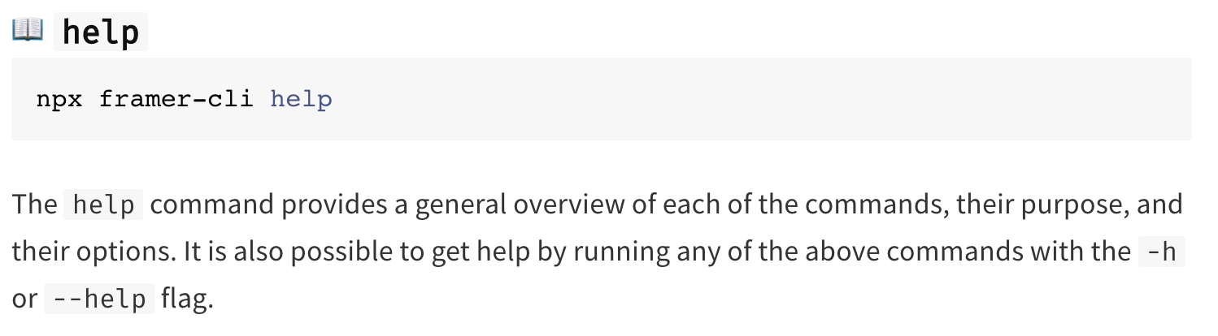

Slide 8
THANK YOU Navid Tavalaei

